Slide 1
Things to do before the meeting
Download ParaView: https://www.paraview.org/download/
Access to Google Colab Notebook: https://colab.research.google.com/drive/1Tbm49gRwDpvYKg5ukrrtfSo8yshRLil7?usp=sharing

Slide 2
Outline
Example for easy visualization of 3D data using ParaView
XCT data analysis and visualization needed for PFLOTRAN modeling
Google Colab notebook
3D visualization using ParaView

Slide 3
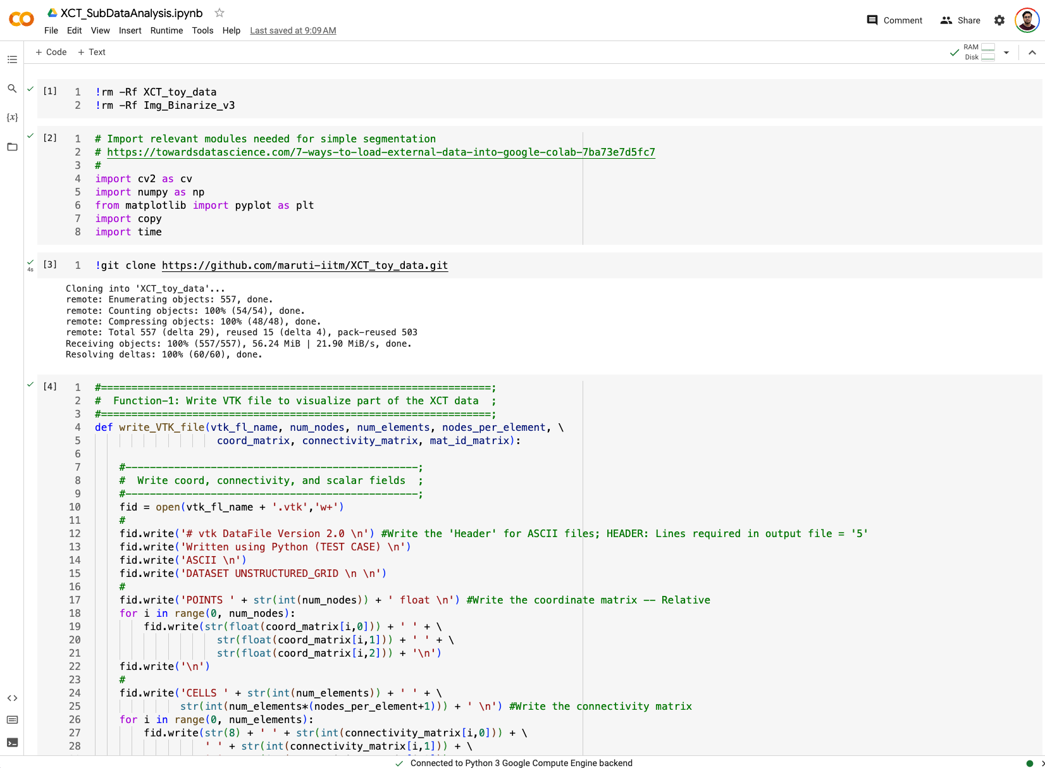
XCT data analysis – Google Colab Notebook

Slide 4
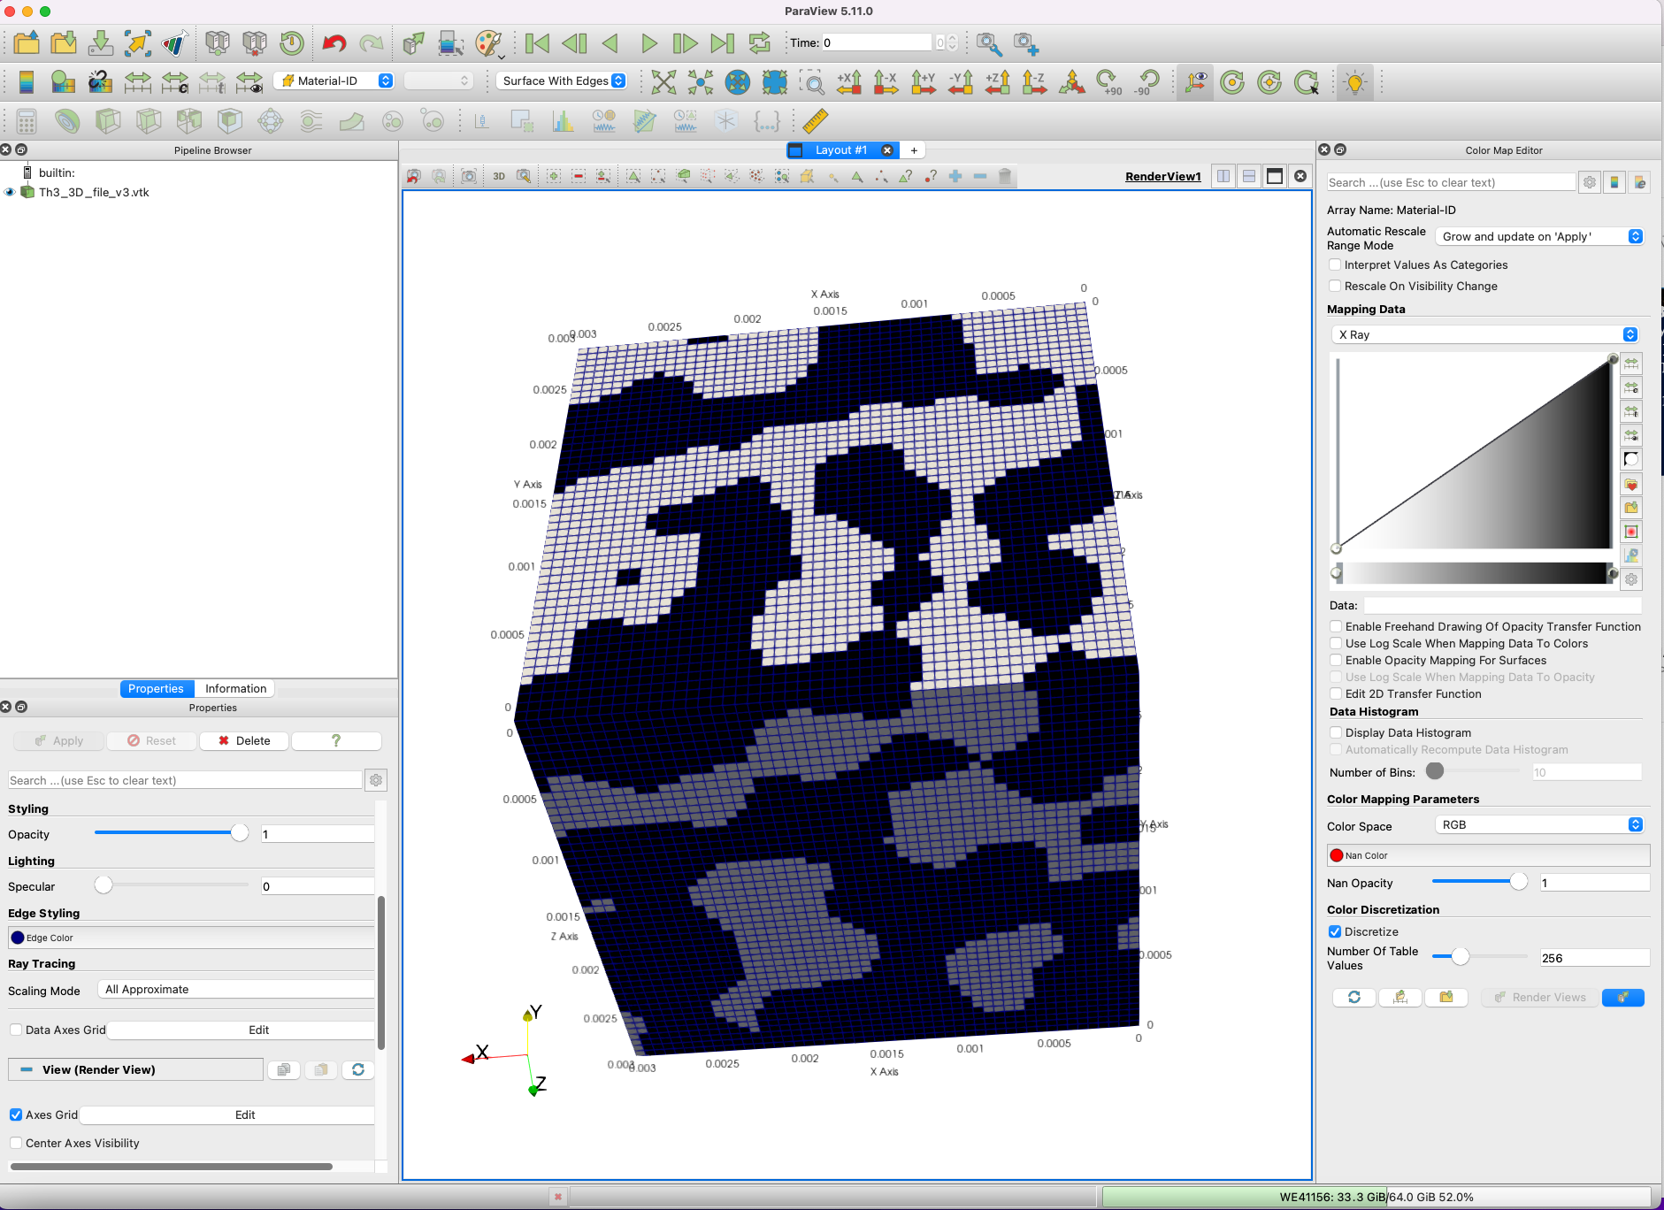
XCT segmented data visualization – ParaView (VTK files)

